Slide 1
BASES TECHNOLOGIQUES DES RÉSEAUX MOBILES : 2G, 3G, 4G, 5G
Aliou Bamba, Ph.D,
Consultant en Télécommunications

Slide 2
Outline
Introduction
Evolution des réseaux mobiles
Caractéristiques de l’interface radio
Architecture des réseaux mobiles
Réseau de deuxième génération (GSM)
Réseau GPRS/EDGE
Réseau de troisième génération (UMTS)
Réseau de quatrième génération (LTE)
Cœur réseau avancées (IMS)
Conclusions

Slide 3
Introduction
The foundation of mobile telephony
Mobile telephony for everyone
The foundation of mobile broadband
Further enhanced mobile broadband
???
1G
AMPS TACS
NMT
2G
GSM D-AMPS
IS 95
3G
WCDMA/HSPA CDMA 2000
4G
LTE
5G
1980
1990
2000
2010
2020

Slide 4
Wireless Communication Systems
Transition from 2G to 3G (2.5G):
Intermediate standards to 3G
Motivation: Avoiding costs for new transmission technologies and infrastructure
HSCSD (High Speed Circuit Switched Data)
GPRS (General Packet Radio Service)
New Core Network (routing)
Importance of IP and internet access

Slide 5
Wireless Communication Systems
Transition from 2G to 3G (2.5G):
EDGE (Enhanced Data for Global Evolution)
GSM/GPRS upgrade (TDMA/FDMA)
Modulation Enhancement (8-PSK, Phase Shift Keying)
Attractive for operators which cannot afford a licence for the radio spectrum
Possible data rate of 384 kbit/s

Slide 6
Introduction to GPRS
1.1. What is GPRS ?
1.2. GPRS access interfaces and reference points
1.3. How is GPRS seen by external networks and GPRS users
1.4. Air interface resources
1.5. GPRS characteristics
1.6. Applications

Slide 7
Introduction to GPRS
It is an enhancement of GSM.
Allocation to GPRS is done dynamically according to capacity on demand.
GPRS is also allow for broadcast multicast and unicast services.

Slide 8
Introduction to GPRS
Part of GSM phase 2+
General Packet Radio Service
General -> not restricted to GSM use (DECT ?, 3rd generation systems ?)
Packet Radio -> enables packet mode communication over air
Service, not System -> existing BSS (partially also NSS) infrastructure is used
Requires many new network elements into NSS
Provides connections to external packet data networks (Internet, X.25)
Main benefits
Resources are reserved only when needed and charged accordingly
Connection setup times are reduced
Enables new service opportunities

Slide 9
1.5. GPRS characteristics
GPRS uses packet switched resource allocation
resources allocated only when data is to be sent/received
Flexible channel allocation
one to eight time slots
available resources shared by active users
up and down link channels reserved separately
GPRS and circuit switched GSM services can use same time slots alternatively
Traffic characteristics suitable for GPRS
Intermittent, bursty data transmissions
Frequent transmissions of small volumes of data
Infrequent transmission of larger volumes of data

Slide 10
GPRS architecture
2.1. Interfaces, reference points and network elements
2.2. Functional view on GPRS
2.3. Subscription of GPRS service
2.4. New network elements
2.4.1. GGSN
2.4.2. SGSN
2.4.3. Other elements
2.4.4. GPRS backbones
2.5. GPRS Mobile classes
2.6. MS multislot capabilities

Slide 11
GPRS access interfaces and reference points
GPRS provides packet switched connections from MS to packet data networks (PDN)
Different operator’s GPRS networks are connected through Gp interface

Slide 12
2.1. Interfaces, reference points and network elements

Slide 13
GPRS architecture and interfaces
SGSN
G_{n}
MS
BSS
SGSN
GGSN
PDN
U_{m}
G_{b}
G_{n}
G_{i}
HLR/
GR
MSC
VLR
EIR
Notes:
Serving GPRS Support Node (SGSN)
Gateway GPRS Support Node (GGSN)
GlobalRoamer (GR)

Slide 14
GPRS protocol architecture
MS
U_{m}
BSS
G_{b}
SGSN
G_{n}
GGSN
G_{i}
apps.
IP/X.25
IP/X.25
SNDCP
SNDCP
GTP
GTP
LLC
LLC
UDP/TCP
UDP/TCP
RLC
RLC
BSSGP
BSSGP
IP
IP
MAC
MAC
FR
FR
L1/L2
L1/L2
radio
radio
Notes:
Sub-network dependent convergence protocol (SNDCP)
Base Station System GPRS Protocol (BSSGP)
Radio Link Control/Medium Access Control (RLC /MAC) protocol
GPRS Tunneling Protocol (GTP)

Slide 15
2.2. Functional view on GPRS

Slide 16
Assignment of functions to general logical architecture

Slide 17
Gateway GPRS Support Node
GGSN
Typically located at one of the MSC sites
One (or few) per operator
Main functions
Interface to external data networks
Resembles to a data network router
Forwards end user data to right SGSN
Routes mobile originated packets to right destination
Filters end user traffic
Collects charging information for data network usage
Data packets are not sent to MS unless the user has activated the PDP address

Slide 18
Serving GPRS Support Node
SGSN
Functionally connected with BSC, physically can be at MSC or BSC site
One for few BSCs or one (or few) per every BSC
One SGSN can support BSCs of several MSC sites
Main functions
Authenticates GPRS mobiles
Handles mobile’s registration in GPRS network
Handles mobile’s mobility management
Relays MO and MT data traffic
TCP/IP header compression, V.42bis data compression, error control MS- SGSN (ARQ)
Collect charging information of air interface usage

Slide 19
Security: Based on GSM phase 2
Authentication
SGSN uses same principle as MSC/VLR:
Get triplet, send RAND to MS, wait for SRES from MS, use Kc
MS can’t authenticate the network
Key management in MS
Kc generated same way from RAND using Ki as in GSM
Ciphering
Ciphering algorithm is optimized for GPRS traffic (‘GPRS - A5’)
Ciphering is done between MS and SGSN
User confidentiality
IMSI is only used if a temporary identity is not available
Temporary identity (TLLI) is exchanged over ciphered link

Slide 20
GPRS Attach
GPRS Attach function is similar to IMSI attach
Authenticate the mobile
Generate the ciphering key
Enable the ciphering
Allocate temporary identity (TLLI)
Copy subscriber profile from HLR to SGSN
After GPRS attach
The location of the mobile is tracked
Communication between MS and SGSN is secured
Charging information is collected
SGSN knows what the subscriber is allowed to do
HLR knows the location of the MS in accuracy of SGSN

Slide 21
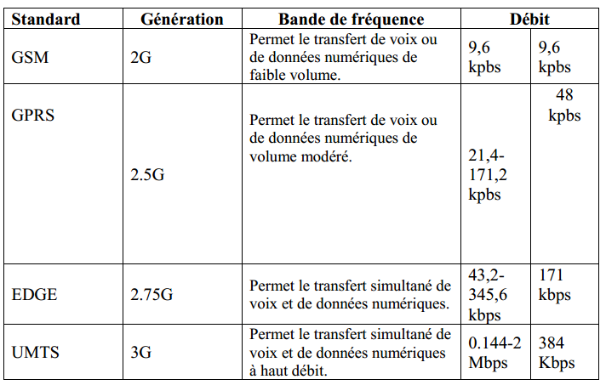
FROM 2G TO 3G

Slide 22
Introducing UMTS
Third Generation – IMT-2000:
IMT-2000 (International Mobile Telecommunications at 2000 MHz)
A standard created by the ITU (International Telecommunications Union)
Different standards grouped together, to support existing infrastructure
UMTS Characteristics
Requirements:
High data rates
Flexible operating environments
Spectral efficiency/capacity
Multimedia services
Packet data network and IP mobility
Global roaming
Quality of service
Interoperability with 2G network

Slide 23
UTRAN Technology - FDD
UTRA – FDD:
Paired frequency bands
Two 5 MHz bands, for uplink and downlink
Duplex distance of 190 MHz
Signal spreading (Channelization code)
W-CDMA
Transfer rate of 3.84 million symbols per second (Mcps)
Primary technology for UMTS in Europe

Slide 24
UTRAN Technology - TDD
UTRA – TDD:
Unpaired frequency bands
One single 5 MHz band
Usage of time slots
Configuration of symmetric services
Configuration of asymmetric services
Advantage for data transmissions
One frame (10 ms) consists of 15 timeslots
Signal spreading (Channelization code)
W-CDMA combined with TDMA

Slide 25
UTRAN Technology - TDD
Types of Cells and Base station to use them
Cells will operate in a hierarchy overlaying each other
Pico Cells will operate in a Time division Duplex (TDD) mode
TDD mode will use the same frequency to send and receive with a time frame being allocated.
All other cells will operate in Frequency Division Duplex (FDD) Mode
FDD will operate in the same manner as GSM, with a different frequencies for the Uplink and Downlink

Slide 26
UTRA – FDD (W – CDMA)
The Frequency Division Duplex (FDD) mode for UTRA uses wide band CDMA.
The radio frame consists of 15 time slots.
One radio time consists 38,400 chips with a duration of 10ms.
There are three physical channels that are used for data transmission.
Two are used for uplink and one is used for downlink.

Slide 27
UMTS Specifications
Based on GSM standards
The 3G standard was written by the International Telecommunication Union (ITU)
The standard was referred to as IMT-2000
Transfer rates:
144 kbps – Satellite and rural outdoor, (i.e., macrocell, max speed of 500 km/h)
384 kbps – Urban outdoor (i.e., microcell, max speed of 120 km/h)
2048 kbps – Indoor and low range outdoor (i.e., picocell, max speed of 10 km/h)
Objective to provide fairly high-speed wireless communications to support multimedia, data, and video in addition to voice
Difficult to predict
Actual distances and bandwidth depend on local conditions
Voice quality comparable to PSTN

Slide 28
UMTS Specifications
Bit Error Rate (BER)
Real-time applications: 10⁻³ to 10⁻⁷ with maximum constant delay: 20ms to 300 ms
No real-time applications: 10⁻⁵ to 10⁻⁸ with maximum delay >= 150ms.
Spectrum: 1900 MHz-2025 MHz, and 2110 -2200 MHz
FDD (macro- and micro- cells: uplink is from 1920 MHz to 1980 MHz, downlink is from 2110 MHz to 2170 MHz
TDD (pico- cells: not divided by use of different frequency carriers (not suitable for large prop delays).

Slide 29
UMTS Specifications
UMTS Advantages:
Improved capacity (4 to 5 times higher compared with GSM)
Variable bit rate
Quick and secure connection establishment
Breathing cells
Improved signal to noise ratio
Broadband spectrum
Macro diversity

Slide 30
UMTS Specifications
Voice quality comparable to PSTN
Uses a pair of 5 MHz channels
Symmetrical and asymmetrical data rates
Support for packet-switched and circuit-switched services
More efficient use of available spectrum
Support for variety of mobile equipment
Flexibility to allow introduction of new services and technologies
Frequency bands:
Uplink: 1885-2025 MHz
Downlink: 2110-2200 MHz

Slide 31
UMTS Specifications
UMTS
UMTS provides different types of Quality of Service (QoS)
Offers voice and data services the same as EDGE
Services offered will be classed into one of the following
From these classes certain defined Quality of Service (QOS) specifications are guaranteed like packet delay time
Conversational | Streaming | Interactive | Background
Real-Time |  | Best-effort, guarantee of quality delivery
Voice | Streaming Video on Demand | Web Pages, network gaming | MMS, SMS, emails, downloading

Slide 32
Quality-of-Service: What, Why?
Quality of Service (QoS) is the ability of a network element (e.g. an application, host or router) to have some level of assurance that its traffic and service requirements can be satisfied.
Newer applications with multimedia content
Demands of convergence
More bandwidth ?
User perception of service quality can be translated to network flow parameters such as delay and delay variation.

Slide 33
Guidelines for providing QoS to users
QoS perceived by the user must be end-to-end.
Parameters defining QoS of a flow must be fewer and simpler.
QoS definition must be compatible with all kinds of applications.
Must be able to quantify and enforce.

Slide 34
QoS attributes for Traffic Classes

Slide 35
QoS Characteristics of UMTS Classes
Very important
1
0.9
Conversational
0.8
Streaming
0.7
Interactive
0.6
Background
0.5
0.4
0.3
less important
0.2
0.1
0
delay
throughput
retransmission

Slide 36
UMTS Technical features compared with GSM
UMTS is downward compatible to GSM technology but will be capable to offer advanced features beyond existing GSM systems
UMTS
GSM
Up to 2 Mbit mobile packet data
Up to 384 Kbit mobile video
Fixed/mobile convergence of protocols
Switching platform based on GSM II+
Wide range of terminals: voice, data only, multimedia
Downward compatible to GSM networks
Coverage limited but roaming available
9.6 Kbit/s data, up to 112 Kbit/s with GPRS
Up to 64 Kbit/s mobile video with HSCSD
Services similar to ISDN
GSM switching platform
Primarily voice terminals, first organiser announced
No compatibility to other networks
Full coverage, worldwide roaming

Slide 37
UMTS Specifications
Types of Cells and Base station to use them
Cells will operate in a hierarchy overlaying each other
Global
Satellite
Suburban
Urban
In-Building
Micro-Cell
Pico-Cell
Macro-Cell

Slide 38
UMTS Air Interface
Radio Interface
UMTS uses Wideband-Code Division Multiple Access (W-CDMA)
Also known as “IMT-2000 Direct Spread”
Extremely complex algorithms
Uses 10x the current 2G processing power!
Modulation is done with Quadrature phase shift keying (QPSK)
This encodes 2 bits with each change
Supports two modes of operation
Frequency Division Duplex (FDD)
Time Division Duplex (TDD)
W-CDMA
Operates in the same manner as the CDMA used in the US
CDMA allows multiple users to communicate at the same time over the same frequency
Each of the devices is given a “Chipping code” this is known by the device and the base station.
This chipping code is then used to identify the signal and allows the BS to receive the signal
The chipping code is used to adjust the frequency of data transferred during the transfer
The essential point of CDMA is the use of power control

Slide 39
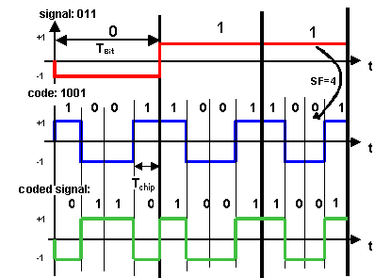
UMTS Air Interface
W-CDMA:
Signal coding:
Non Return To Zero Transmission
Signal bit combined with code pattern (chips)
Every bit is substituted with the resulting pattern
Increased data rate
Increased need of bandwidth
Band spreading

Slide 40
WCDMA Air Interface
In UMTS, the UTRAN is used to keep the mobility management (MM) and connection management (CM) layers independent of the air interface radio technology
This idea is realized as the concepts of access stratum (AS) and nonaccess stratum (NAS)
AS: functional entity that includes radio access protocols between the user equipment (UE) and the UTRAN (terminate here).
NAS: includes core network (CN) protocols between the UE and the CN itself.
The NAS protocols can be kept the same, thus, the GSM’s MM and CM resources are used almost unchanged in 3G NAS.

Slide 41
UMTS architecture (Release 99)
UTRAN (UTRA Network)
Cell level mobility
Radio Network Subsystem (RNS)
Encapsulation of all radio specific tasks
UE (User Equipment)
CN (Core Network)
Inter system handover
Location management if there is no dedicated connection between UE and UTRAN
U_{u}
I_{u}
UE
UTRAN
CN

Slide 42
UMTS Architecture
GSM/GPRS networks use Time Division Multiple Access (TDMA) and Frequency Division Multiple Access (FDMA) air interface transmission
UMTS networks use Wide-band Code Division Multiple Access (WCDMA), 2 modes of operation (Frequency Division Duplex (FDD) and Time Division Duplex (TDD))
Requires new radio access network (RAN) called UMTS Terrestrial RAN (UTRAN)
UTRAN introduces 2 new network elements:
Radio Network Controller (RNC) equivalent to BSC
Node B equivalent to BTS (extends service to multiple cells)

Slide 43
UTRAN Architecture
Core Network
Iu
Iu
RNS
Iur
RNS
RNC
RNC
Iub
Iub
Iub
Iub
Node B
Node B
Node B
Node B
Notes:
7

Slide 44
UTRAN Architecture
UE
UTRAN
CN
Core network
protocols
Non-access Stratum
Core network
protocols
Access Stratum
Radio
Protocols
Radio
Protocols
lu
Protocols
lu
Protocols
Uu-interface
Iu-interface

Slide 45
UMTS – Architecture
UTRA Network - Universal Terrestrial Radio Access Network .
The UTRAN is connected to user equipment (UE) via a radio interface via Uu and via Iu interface the UTRAN communicates with core Network (CN).
It handles cell level mobility and comprises several Radio Network Sub system (RNS).
The functions of RNS include ciphering, deciphering hand over control, Radio resource management.
It contains functions for inter system hand over, gate ways to other system networks etc.,

Slide 46
User Equipment
UMTS uses USIM which identifies the subscriber to the core network
USIM functions:
Supports multiple user profiles
Security
User authentication
UE is attached to both packet-switched (data) and circuit-switched (voice) domains and can concurrently use both services

Slide 47
Node B
Node B is the UMTS equivalent of a base station transceiver. It may support one or more cells, although in general only one cell one Node B.
Provide service to one or more cells
Can be physically located within existing GSM BTS
Uses WCDMA to connect to UE
Support both FDD and TDD modes
ATM switching between Node B and RNC
Monitoring quality & strength of connection and calculates frame error rates
Other functions include:
Air transmission and reception, CDMA physical channel coding
Modulation and demodulation, Closed loop power control
Mapping of Node B logical resources onto hardware resources
Uplink power control
Reporting of uplink interference measurements and downlink power information
Contains the air interface physical layer, performs many functions such as RF processing, modulations, coding, and so on.

Slide 48
Radio Network Controller (RNC)
One RNC controls one or more Node Bs.
It may be connected via Iu interface to an MSC (IuCS), or to an SGSN via Iu (IuPS).
The interface between RNCs (Iur) is logical interface, and a direct physical connection does not necessarily exist.
An RNC is comparable to a base station controller (BSC) in GSM networks.

Slide 49
Radio Network Controller (RNC)
RNC provides centralized control of node B elements
Interfaces are ATM-based
Radio Resource Management is distributed to the RNC (GSM RRM is performed in the core network)
Other RNC functions:
Connection to User Equipment (UE), Soft handover
Congestion control, Handover control
Broadcast signaling, Ciphering
Channel allocation, Call admission control
Encryption / Decryption
ATM switching and multiplexing , protocol conversion
Radio Resource Control, Code Allocation
Power control, Hand over control
Management

Slide 50
Core Network (CN)
The Circuit Switched Domain (CSD) comprises the classical circuit switched services including signaling.
Resources are reserved at connection setup and GSM components MSC, GMSC (Gate way Mobile Switching Network) and VLR are used.
The Packet Switched Domain (PSD) uses GPRS components SGSN and CGSN and connects to the RNS interface.

Slide 51
Core network
The Core Network (CN) and thus the Interface I_{u}, too, are separated into two logical domains:
Circuit Switched Domain (CSD)
Circuit switched service incl. signaling
Resource reservation at connection setup
GSM components (MSC, GMSC, VLR)
I_{u}CS
Packet Switched Domain (PSD)
GPRS components (SGSN, GGSN)
I_{u}PS
Release 99 uses the GSM/GPRS network and adds a new radio access!
Helps to save a lot of money …
Much faster deployment
Not as flexible as newer releases (5, 6)

Slide 52
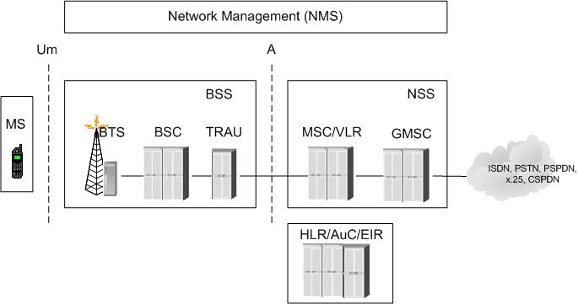
From Mobile Networks to UMTS Revolution (1/6)
GSM Network

Slide 53
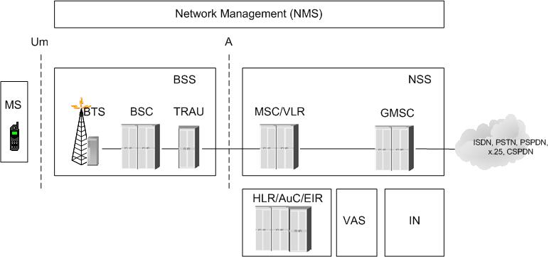
From Mobile Networks to UMTS Revolution (2/6)
VALUE ADDED Service Platform

Slide 54
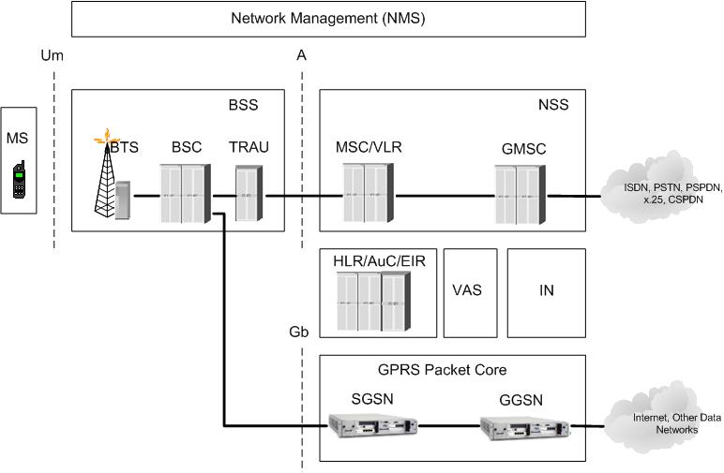
From Mobile Networks to UMTS Revolution (3/6)
GPRS Service

Slide 55
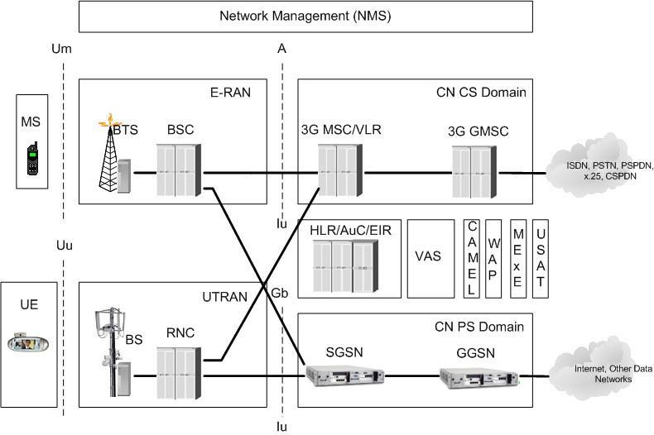
From Mobile Networks to UMTS Revolution (4/6)
3GPP R99 Network

Slide 56
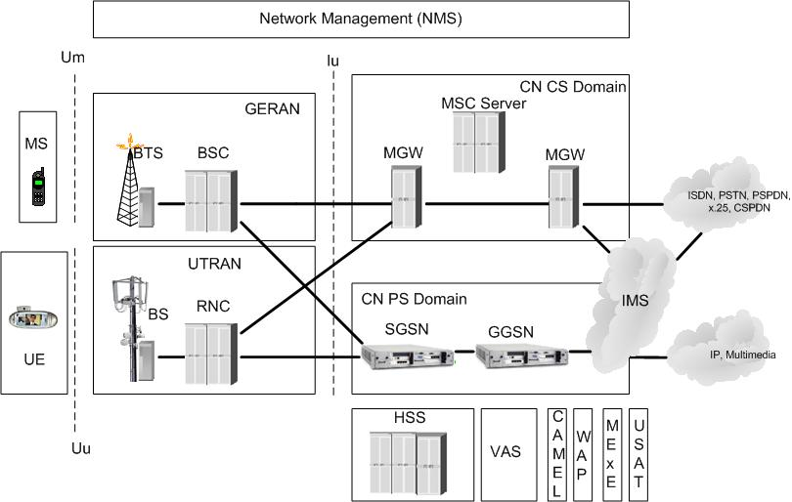
From Mobile Networks to UMTS Revolution (5/6)
3GPP R4 Network

Slide 57
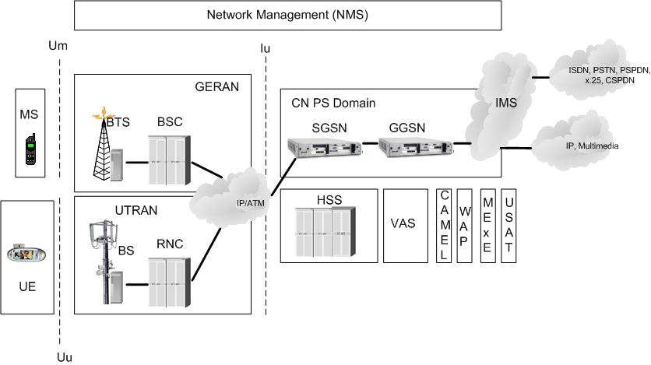
From Mobile Networks to UMTS Revolution (6/6)
3GPP R5 Network

Slide 58
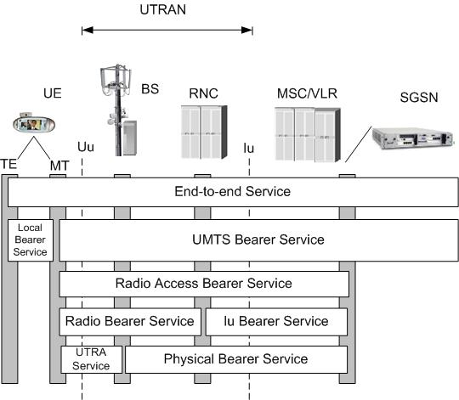
UMTS Radio Access Network (1/7)

Slide 59
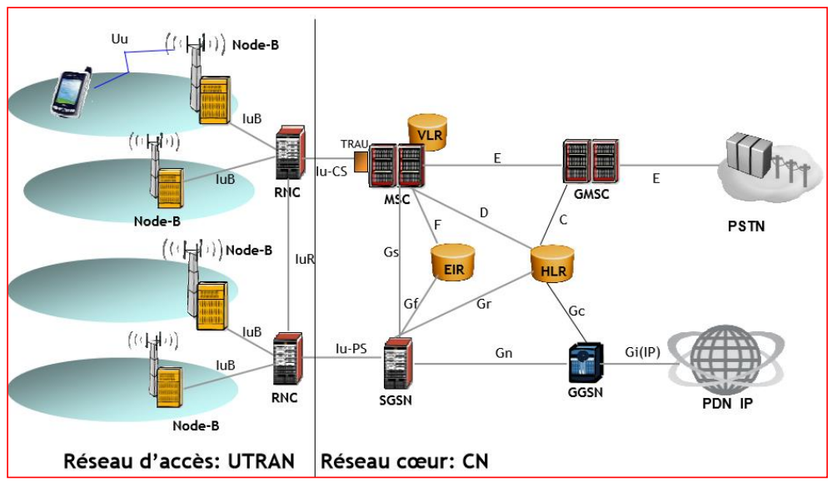

Slide 60
Core network: protocols
VLR
MSC
GMSC
PSTN/
ISDN
RNS
GSM-CS
backbone
HLR
RNS
SGSN
GGSN
PDN (X.25),
Internet (IP)
Layer 3: IP
GPRS backbone (IP)
Layer 2: ATM
SS 7
Layer 1: PDH, SDH, SONET
UTRAN
CN

Slide 61
UMTS protocol stacks (user plane)
UE
U_{u}
UTRAN
I_{u}CS
3G
MSC
apps. &
protocols
Circuit
switched
RLC
RLC
SAR
SAR
MAC
MAC
AAL2
AAL2
radio
radio
ATM
ATM
UE
U_{u}
UTRAN
I_{u}PS
3G
SGSN
G_{n}
3G
GGSN
apps. &
protocols
IP, PPP,
…
IP tunnel
IP, PPP,
…
Packet
switched
PDCP
PDCP
GTP
GTP
GTP
GTP
RLC
RLC
UDP/IP
UDP/IP
UDP/IP
UDP/IP
MAC
MAC
AAL5
AAL5
L2
L2
radio
radio
ATM
ATM
L1
L1

Slide 62
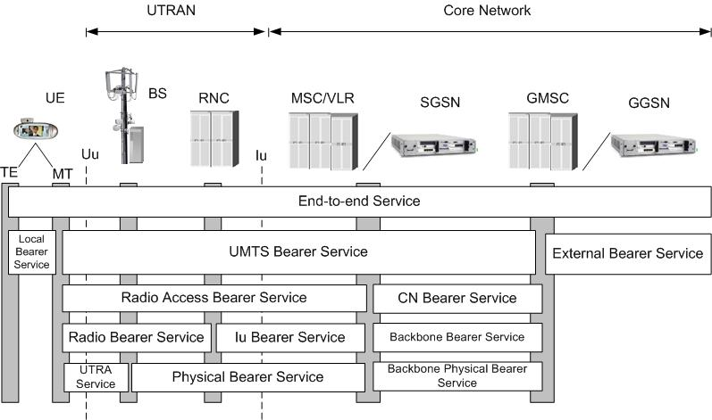
UMTS Core Network (1/2)

Slide 63
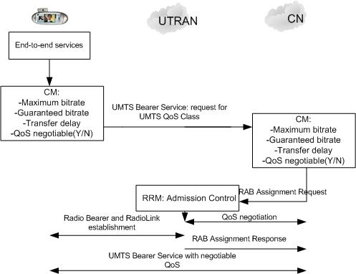
UMTS Core Network (2/2)
end-to-end Services

Slide 64
Spreading and scrambling of user data
Constant chipping rate of 3.84 Mchip/s
Different user data rates supported via different spreading factors
higher data rate: less chips per bit and vice versa
User separation via unique, quasi orthogonal scrambling codes
users are not separated via orthogonal spreading codes
much simpler management of codes: each station can use the same orthogonal spreading codes
precise synchronization not necessary as the scrambling codes stay quasi-orthogonal
data₁
data₂
data₃
data₄
data₅
spr.
code₁
spr.
code₂
spr.
code₃
spr.
code₁
spr.
code₄
scrambling
code₁
scrambling
code₂
sender₁
sender₂

Slide 65
Orthogonal Spreading Variable Factor Coding
1,1,1,1,1,1,1,1
1,1,1,1
...
1,1,1,1,-1,-1,-1,-1
1,1
1,1,-1,-1,1,1,-1,-1
1,1,-1,-1
...
X,X
1,1,-1,-1,-1,-1,1,1
X
1
1,-1,1,-1,1,-1,1,-1
X,-X
1,-1,1,-1
...
1,-1,1,-1,-1,1,-1,1
SF=n
SF=2n
1,-1
1,-1,-1,1,1,-1,-1,1
1,-1,-1,1
...
1,-1,-1,1,-1,1,1,-1
SF=1
SF=2
SF=4
SF=8

Slide 66
Logical Channels in UTRAN
Control Channel (CCH)
Broadcast Control Channel (BCCH)
Paging Control Channel (PCCH)
Dedicated Control Channel (DCCH)
Common Control Channel (CCCH)
Shared Channel Control Channel (SHCCH)
ODMA Dedicated Control Channel (ODCCH)
ODMA Common Control Channel (OCCCH)
Traffic Channel (TCH)
Dedicated Traffic Channel (DTCH)
ODMA Dedicated Traffic Channel (ODTCH)
Common Traffic Channel (CTCH)

Slide 67
Dedicated Physical Control CHannel (DPCCH)
The channel conveys physical layer control data.
The pilot is used for channel estimation.
The transport Format Combination Identifier (TFCI) specifies the channels transported with in the DPDCHs.
Signaling for slot handover is supported by Feedback Information Field (FBI)
The Transmit Power Control ( TPC ) is used for controlling the transmission power of sender.

Slide 68
Dedicated Physical Data Channel (DPDCH )
The channel conveys user or signaling data
The spreading factor (SF) of this channel is vary from 4 to 256.
The data rates can offer this channel are : 960 kbits/s, 480,240,120,60,30 and 15 kbits / s.
Bandwidth used by the user equipment is wasted due to orthogonal variable spreading factor.

Slide 69
Dedicated Physical Channel (DPCH)
The downlink time of DPCH multiplexes both control and user data.
A Physical Random Access Channel (PRACH) is used for this purpose.
Spreading factors between 4 and 256 are used.
After power on the User Equipment (UE ) has to perform the following steps during the search for a cell.

Slide 70
Dedicated Physical Channel (DPCH)
Primary synchronization :
A UE has to synchronize with the time slot structure with the help of a 256 chip primary code.
Secondary synchronization :
UE is now synchronized with the frame structure.
Identification of the scrambling code :
To find the right code using a correlator.

Slide 71
UMTS FDD frame structure
Radio frame
W-CDMA
1920-1980 MHz uplink
2110-2170 MHz downlink
chipping rate: 3.840 Mchip/s
soft handover
QPSK
complex power control (1500 power control cycles/s)
spreading: UL: 4-256; DL:4-512
10 ms
0
1
2
...
12
13
14
Time slot
666.7 µs
Pilot
TFCI
FBI
TPC
uplink DPCCH
2560 chips, 10 bits
666.7 µs
Data
uplink DPDCH
2560 chips, 10*2^{k} bits (k = 0...6)
666.7 µs
Data₁
TPC
TFCI
Data₂
Pilot
downlink DPCH
DPDCH
DPCCH
DPDCH
DPCCH
FBI: Feedback Information
TPC: Transmit Power Control
TFCI: Transport Format Combination Indicator
DPCCH: Dedicated Physical Control Channel
DPDCH: Dedicated Physical Data Channel
DPCH: Dedicated Physical Channel
2560 chips, 10*2^{k} bits (k = 0...7)
Slot structure NOT for user separation
but synchronization for periodic functions!

Slide 72
UMTS TDD frame structure (burst type 2)
Radio frame
10 ms
0
1
2
...
12
13
14
Time slot
666.7 µs
Data
1104 chips
Midample
256 chips
Data
1104 chips
GP
Traffic burst
GP: guard period
96 chips
2560 chips
TD-CDMA
2560 chips per slot
spreading: 1-16
symmetric or asymmetric slot assignment to UL/DL (min. 1 per direction)
tight synchronization needed
simpler power control (100-800 power control cycles/s)

Slide 73
Support of mobility: macro diversity
Multicasting of data via several physical channels
Enables soft handover
FDD mode only
Uplink
simultaneous reception of UE data at several Node Bs
Reconstruction of data at Node B, SRNC or DRNC
Downlink
Simultaneous transmission of data via different cells
Different spreading codes in different cells
UE
Node B
Node B
RNC
CN

Slide 74
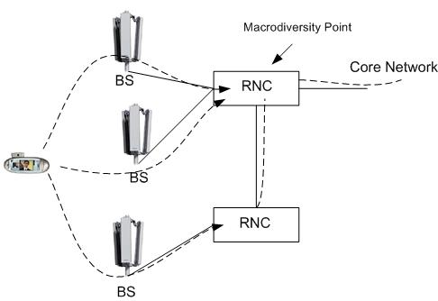
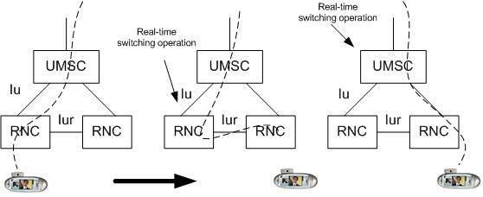
UMTS Radio Access Network
RNC Changes:
Macrodiversity:

Slide 75
Support of mobility: handover
From and to other systems (e.g., UMTS to GSM)
This is a must as UMTS coverage will be poor in the beginning
RNS controlling the connection is called SRNS (Serving RNS)
RNS offering additional resources (e.g., for soft handover) is called Drift RNS (DRNS)
End-to-end connections between UE and CN only via I_{u} at the SRNS
Change of SRNS requires change of I_{u}
Initiated by the SRNS
Controlled by the RNC and CN
Node B
SRNC
CN
I_{ub}
I_{u}
UE
I_{ur}
Node B
DRNC
I_{ub}

Slide 76
Example handover types in UMTS/GSM
UE₁
Node B₁
RNC₁
3G MSC₁
UE₂
I_{u}
Node B₂
I_{ub}
I_{ur}
UE₃
Node B₃
RNC₂
3G MSC₂
UE₄
BTS
BSC
2G MSC₃
A_{bis}
A

Slide 77
Conclusions
WCDMA is used to spreading the data spectrum and hence increase the data rate;
Development of a variety of applications and services with different level of QoS, leading to four classes of services.
Mobile network of third generation is the foundation for broadband communications;
Introduction of PS domain in the CN;
Notion of QoS is addressed for the first time
Communication between network elements through the different interfaces

Slide 78


